Slide 1
Dynamic Programming

Slide 2
Introduction
Dynamic Programming is an algorithm design method that can be used when the solution to a problem may be viewed as the result of a sequence of decisions.
Dynamic Programming is an algorithm design technique for optimization problems (often minimizing or maximizing).
Examples
Knapsack
Optimal Merge Patterns
Shortest Path

Slide 3
Principle of Optimality
This principle states that
an optimal sequence of decisions has the property that whatever the initial state and decision are, the remaining decisions must constitute an optimal decision sequence with regard to the state resulting from the first decision.

Slide 4
Greedy vs DP
The essential difference between the greedy method and dynamic programming is that in the greedy method only one decision sequence is ever generated.
In dynamic programming, many decision sequences may be generated.
However, sequences containing suboptimal subsequences cannot be optimal (if the principal of optimality holds) and so will not (as far as possible) be generated.

Slide 5
Multistage Graphs

Slide 6
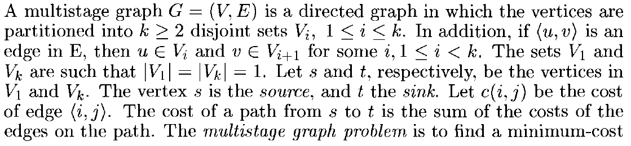
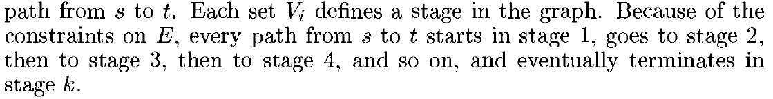
Multistage Graphs

Slide 7
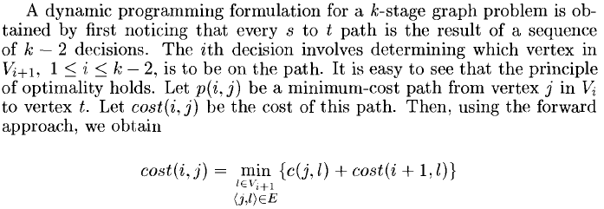
Multistage Graphs

Slide 8
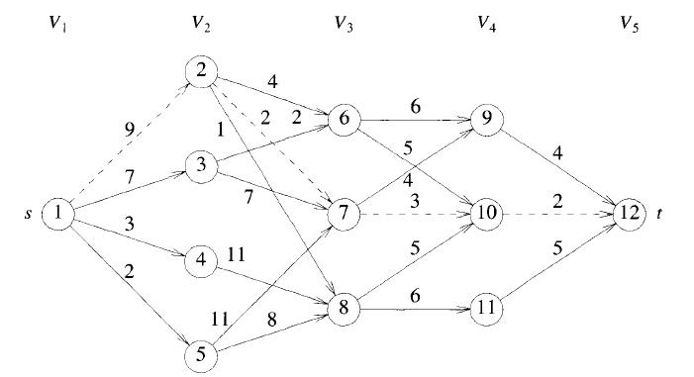
Multistage Graphs

Slide 9
Multistage Graphs

Slide 10
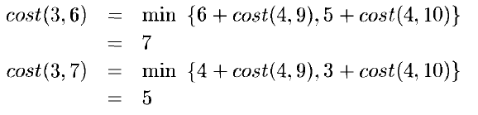
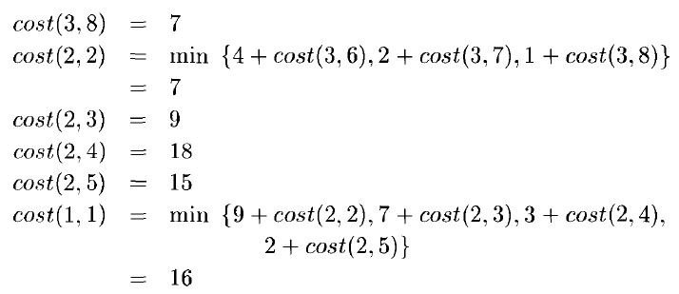
Multistage Graphs

Slide 11
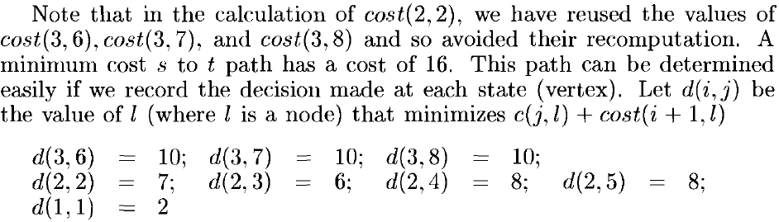
Multistage Graphs : Determining the path

Slide 12
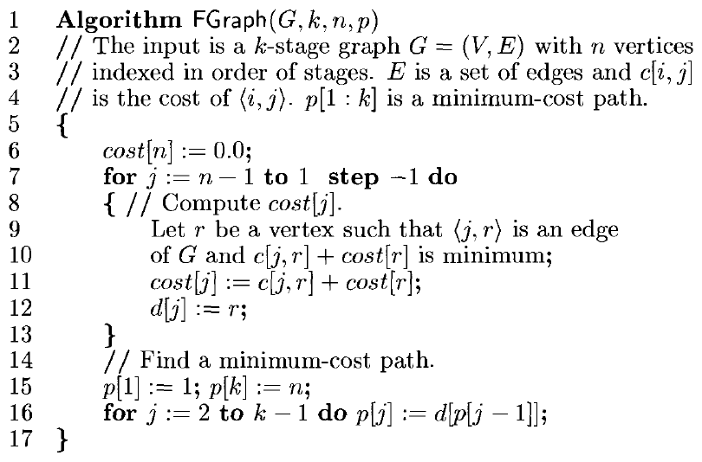
Multistage Graphs : Algorithm

Slide 13
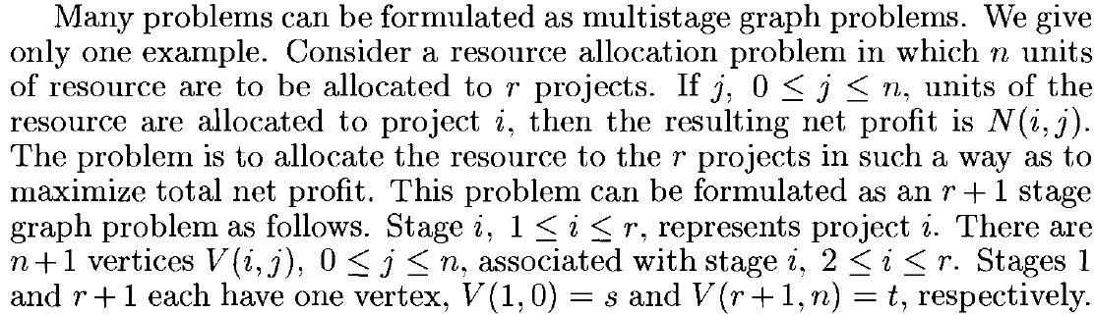
Multistage Graphs : Example

Slide 14
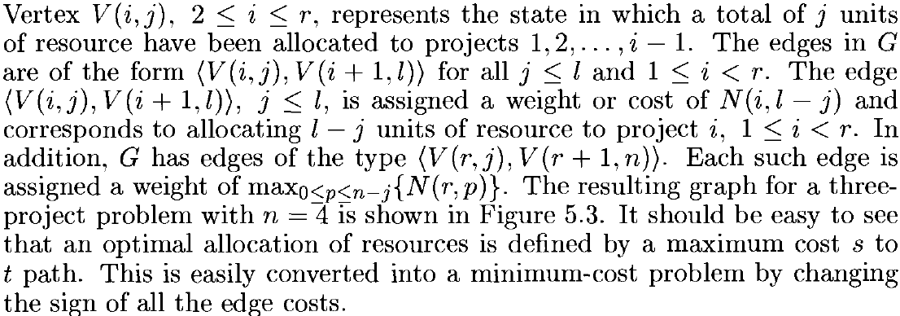
Multistage Graphs : Example
1

Slide 15
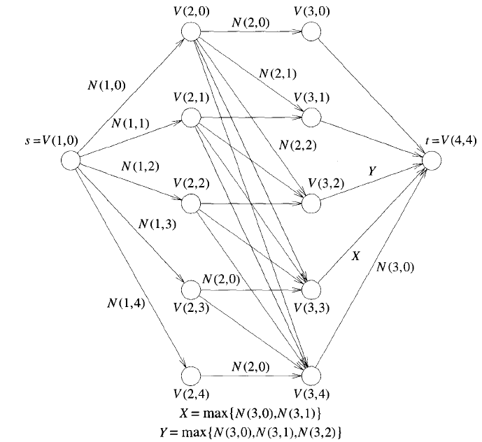
Multistage Graphs : Example
Figure 1

Slide 16
All Pairs Shortest Path

Slide 17
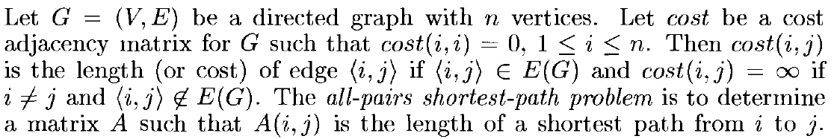
All Pairs Shortest Path

Slide 18
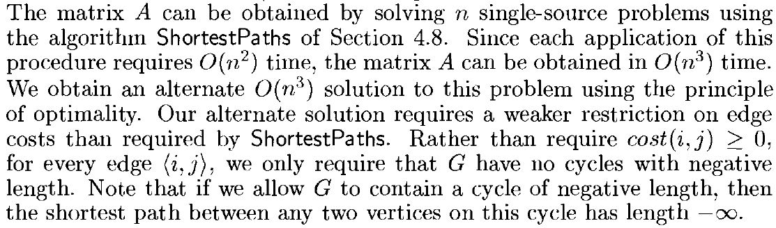
All Pairs Shortest Path
*
* From the Horowitz Sahni Book

Slide 19
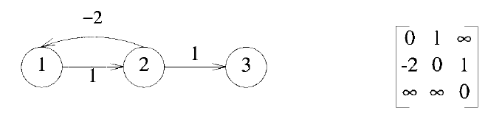
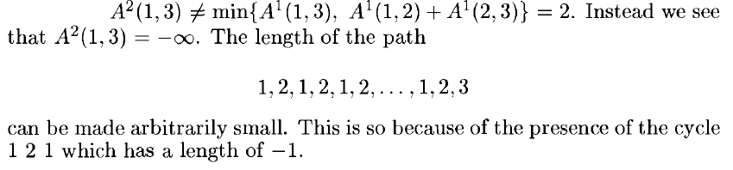
All Pairs Shortest Path : Effect of Negative edge cycle
A⁰
Compute A¹, A² and A³ , using earlier equation

Slide 20
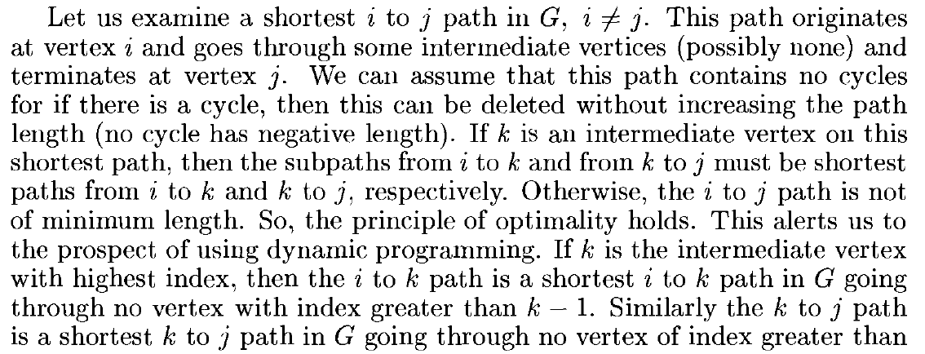
All Pairs Shortest Path
Notes:
Assume index as node number (index) starting with 0 or 1

Slide 21
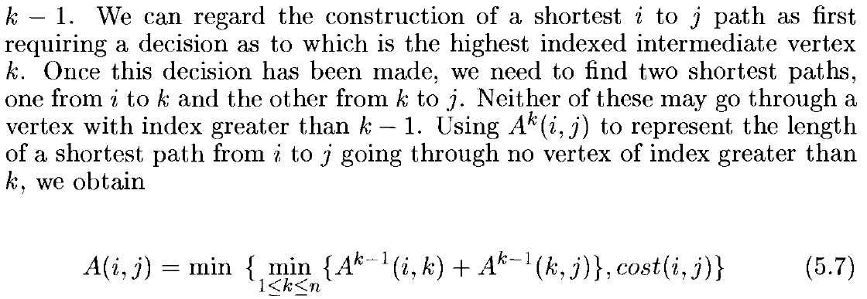
All Pairs Shortest Path

Slide 22
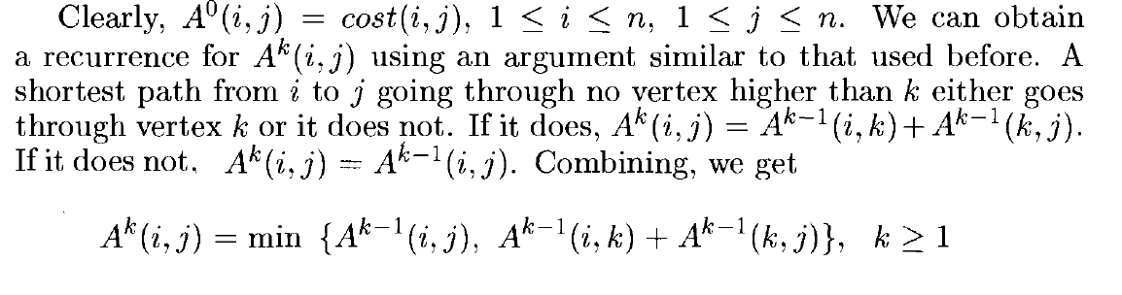
All Pairs Shortest Path

Slide 23
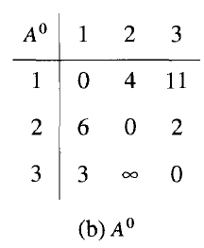
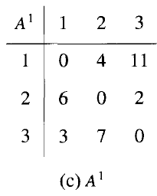
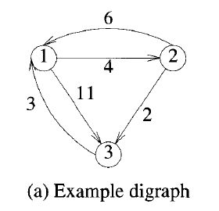
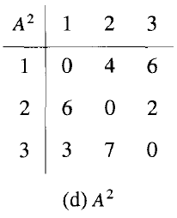
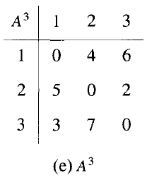
All Pairs Shortest Path : Example
(Node 1 is highest index)
(Node 2 is highest index)
(Node 3 is highest index)

Slide 24
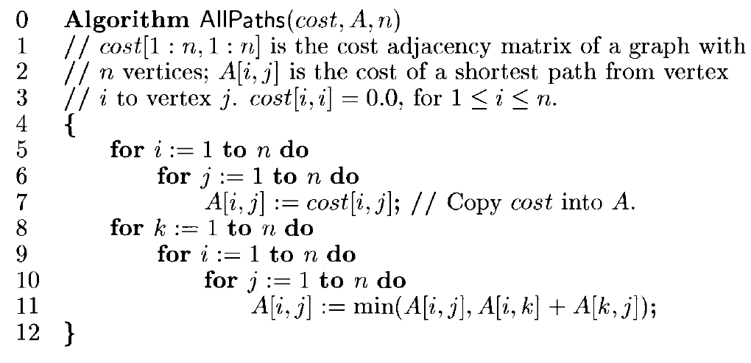
All Pairs Shortest Path : Algorithm

Slide 25
End.

